Slide 1
Report 4th week
Nguyễn Phan Hoàng Phúc - 17520909

Slide 2
RISC-V Architecture
Instruction set
Addressing mode
Hazard
Exception

Slide 3
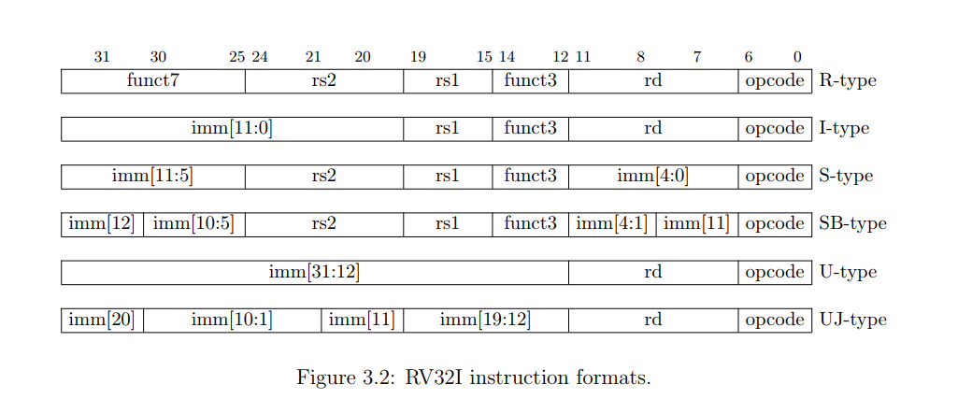
1.Intruction set

Slide 4
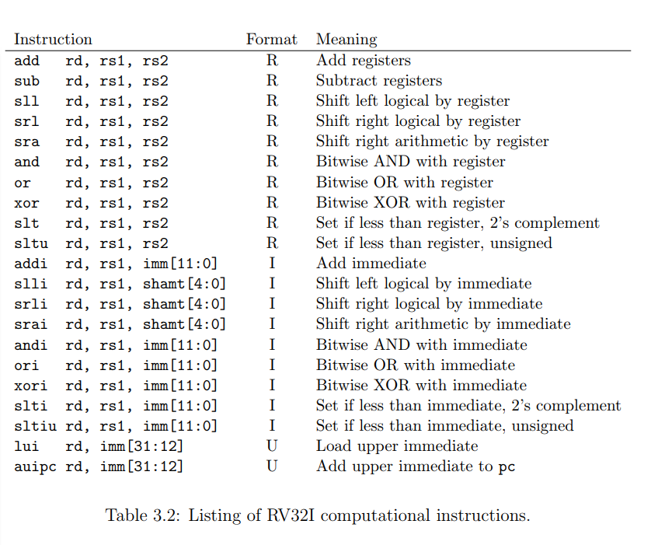
1.Intruction set a. Computational Instructions
lui : set upper 20bits of register rd to 20bit immediate
+ ‘lui’ used in conjunction with ‘addi’ to load arbitrary 32bit const into registers
+ it can also be paired with load and store , indirect jump instructions
auipc: adds a 20-bit upper immediate to the pc and write the result to rd
+ AUIPC was designed to be coupled to JALR to jump anywhere in the 32bit addressing space.

Slide 5
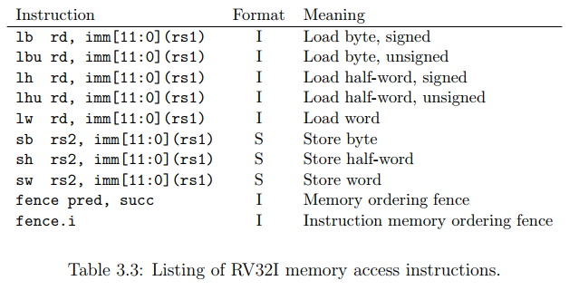
1.Intruction set b. Computational Instructions
FENCE : provide an ordering guarantee between memory accesses prior to the fence and subsequent to the fence, Argument: predecessor set and successor set ( memory reads (R), memory writes(W), device input(I),device output(O))
FENCE.I: provide a guarantee that memory data of previous instruction will be accessible in the subsequent instruction after a FENCE.I has been executed ( in a thread )
=> If apply in multiprocessor system => NEED to use FENCE instruction in additional
For example, the instruction “fence rw,w” guarantees that all loads and stores prior to the fence will not appear to have executed before any store subsequent to the fence.

Slide 6
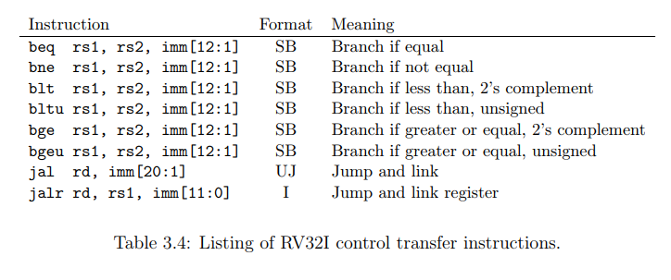
1.Intruction set c. Control Flow Instructions
+ In beq, if rs1 == rs2 => New address will be formed by adding SE 12bit immediate to the current PC ( PC = PC + imm )
+ JAL: set the PC to anywhere, write pc+4 to register rd
+ JALR:(indirect jump) set PC = rs1 + 12imm bit

Slide 7
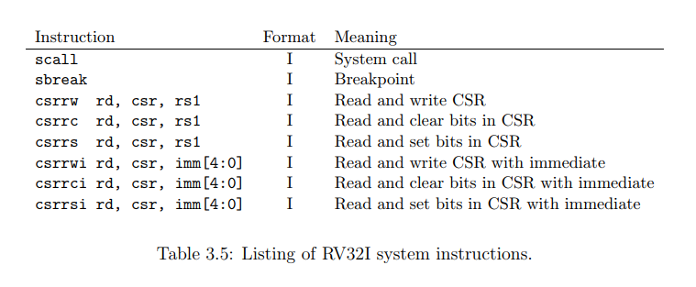
1.Intruction set d. Control Flow Instructions
+SCALL and SBREAK are now replaced by ECALL and EBREAK
+ECALL : invoke the OS the perform system call because RISCV cannot define the parameters passing convention for system call ( property of API)
+EBREAK: generate a breakpoint to invoke the debugger
csrrw rd, csr, rs1 : Read and write CSR =>copy value of a CSR to rd, overwrite CSR with value of rs1
csrrc rd, csr, rs1 : Read and clear bits in CSR => copy old value of CSR to rd => any bit set in rs1 ,clear it in CSR
csrrs rd, csr, rs1 : Read and set bits in CSR => copy old value of CSR to rd => any bit set in rs1 ,SET it in CSR
*CSR: control and status registers

Slide 8
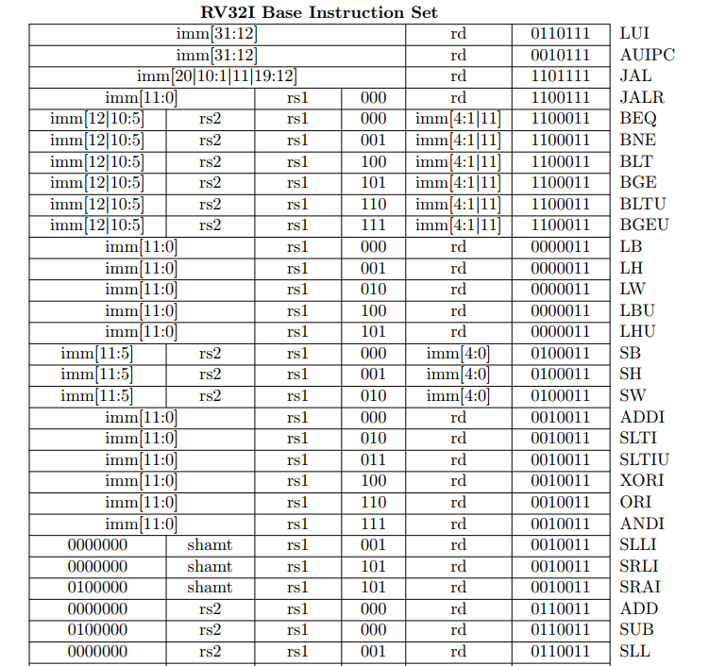
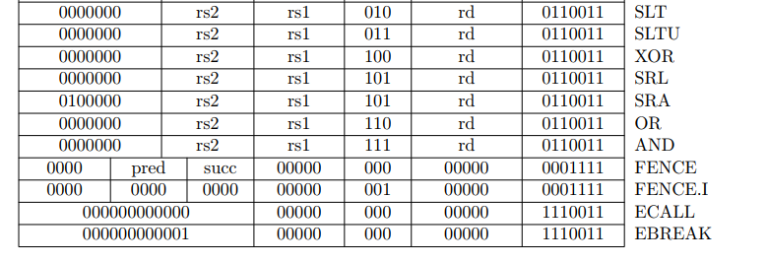
1.Intruction set e.SUMMARY

Slide 9
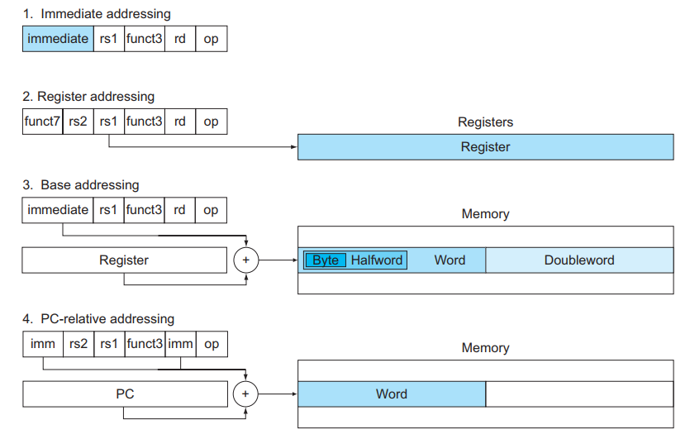
2. Addressing mode

Slide 10
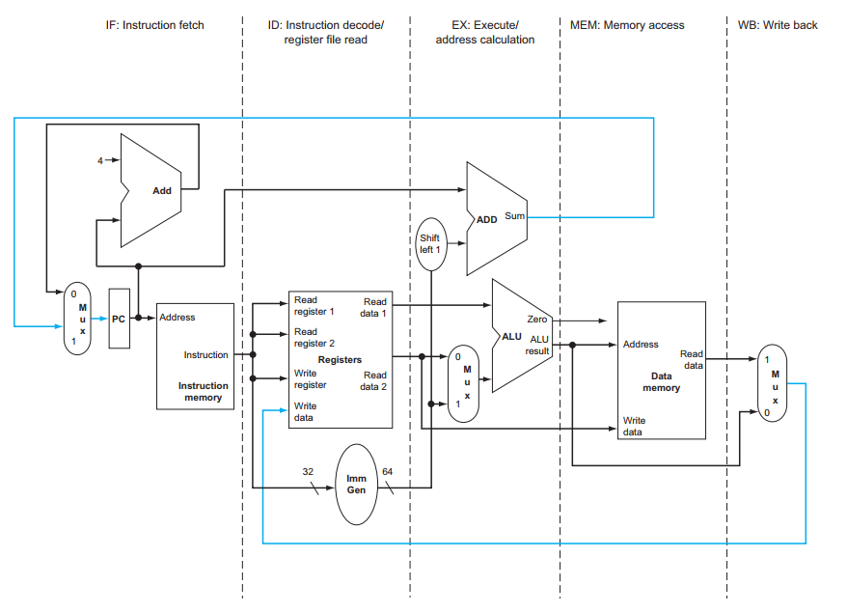
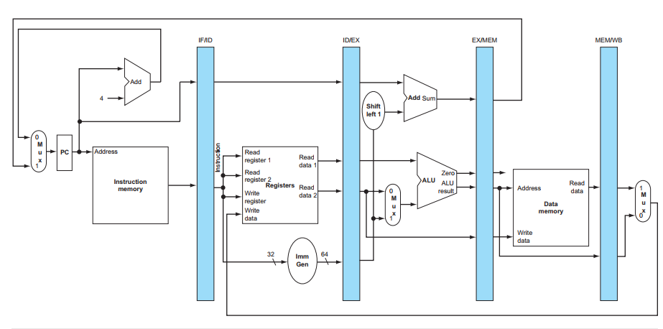
3.Hazard a. Pipeline overview
There are 3 types of hazard:
Structural hazard
Data hazard
Control hazard

Slide 11
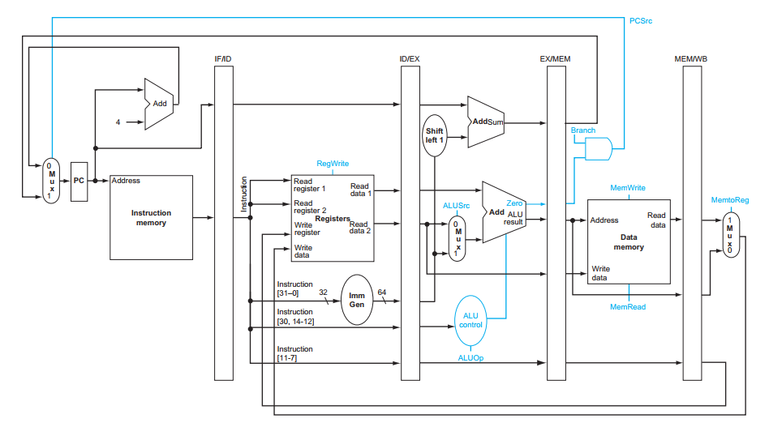
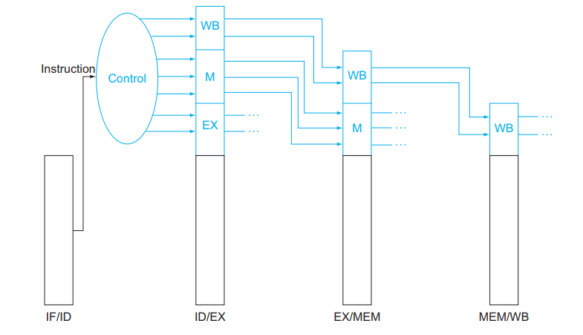
3.Hazard a. Pipeline over view

Slide 12
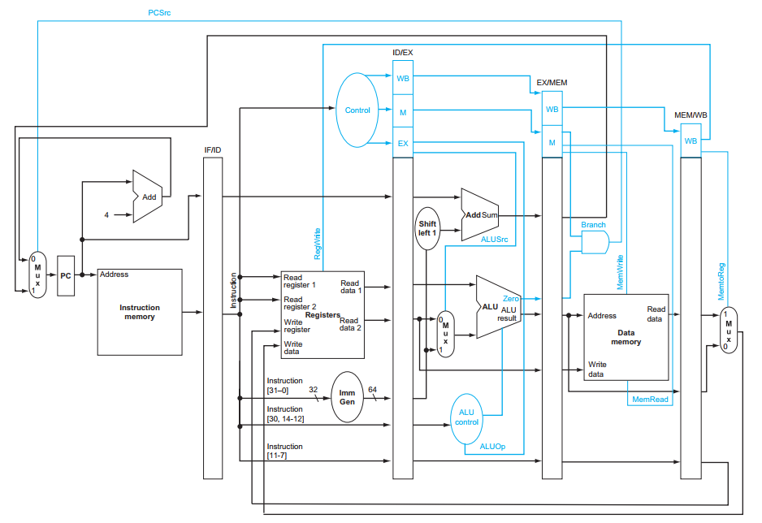
3.Hazard a. Pipeline over view

Slide 13
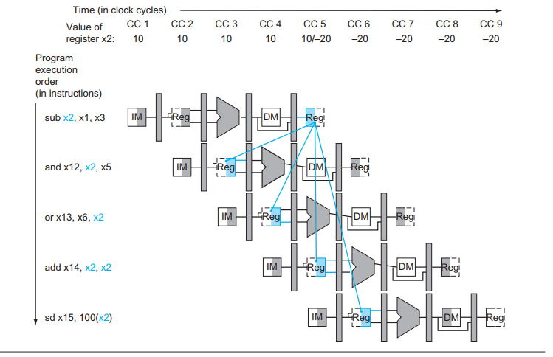
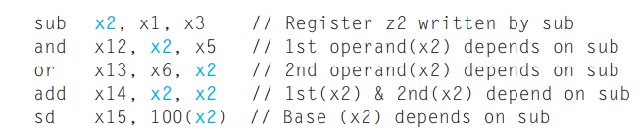
3.Hazard b. Data Hazard
=>The last potential hazard can be resolved by the design of the register file hardware: the write is in the first half of the clock cycle and the read is in the second half => We need forward data in other instructions

Slide 14
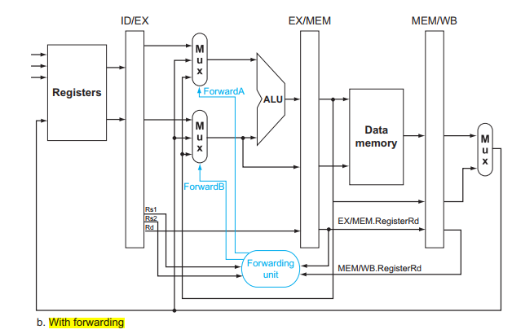
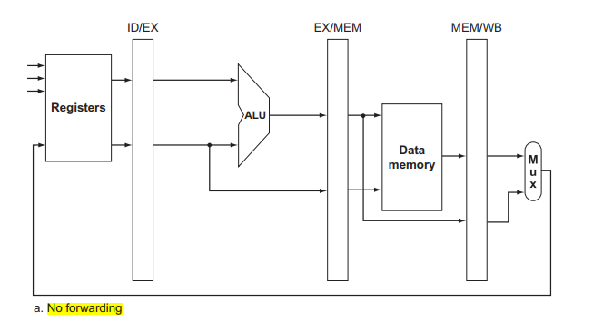
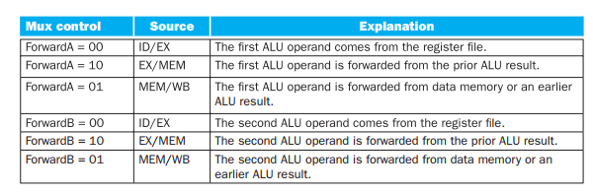
3.Hazard b. Data Hazard
Now we have two pairs of hazard conditions are:
1a. EX/MEM.RegisterRd = ID/EX.RegisterRs1 1b. EX/MEM.RegisterRd = ID/EX.RegisterRs2 2a. MEM/WB.RegisterRd = ID/EX.RegisterRs1 2b. MEM/WB.RegisterRd = ID/EX.RegisterRs2

Slide 15
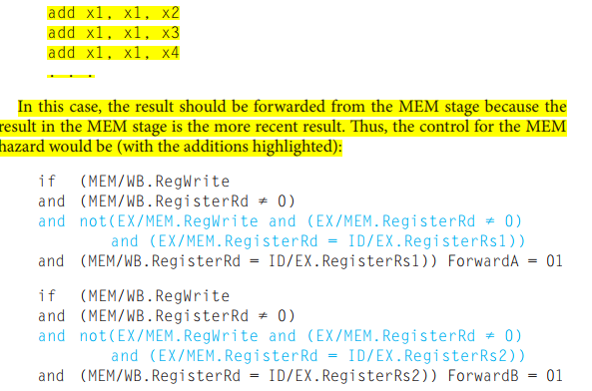
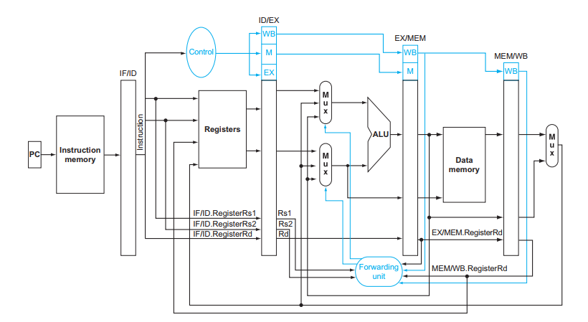
3.Hazard b. Data Hazard
EX hazard:
if (EX/MEM.RegWrite and (EX/MEM.RegisterRd ≠ 0) and (EX/MEM.RegisterRd = ID/EX.RegisterRs1)) ForwardA = 10
if (EX/MEM.RegWrite and (EX/MEM.RegisterRd ≠ 0) and (EX/MEM.RegisterRd = ID/EX.RegisterRs2)) ForwardB = 10
*Lack of a mux in EX stage
2. MEM hazard: if (MEM/WB.RegWrite and (MEM/WB.RegisterRd ≠ 0) and (MEM/WB.RegisterRd = ID/EX.RegisterRs1)) ForwardA = 01 if (MEM/WB.RegWrite and (MEM/WB.RegisterRd ≠ 0) and (MEM/WB.RegisterRd = ID/EX.RegisterRs2)) ForwardB = 01
Other condition: EX/MEM.RegisterRd ≠ 0 to the frst hazard condition and MEM/WB.RegisterRd ≠ 0 to the second.

Slide 16
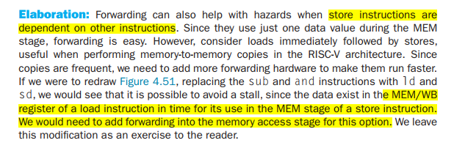
3.HazarD b. DATA Hazard
=> Create a combinational circuit which has condition: EX/MEM.reg = MEM/WB.reg & EX/MEM.MemWrite & MEM/WB.RegWrite ( Guessing )

Slide 17
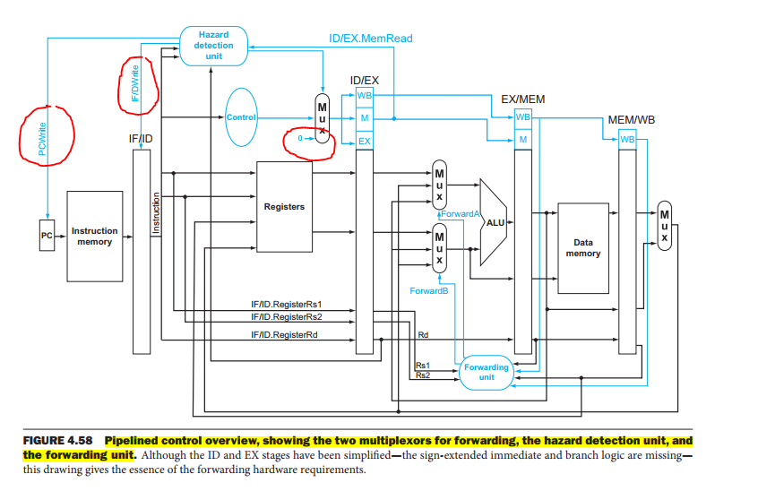
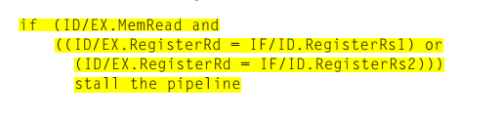
3.Hazard b. Data Hazard
If: An instruction read a register following a load instruction that writes => We have to create a “hazard detection unit”, it operates during the ID stage and will insert the stall between the load and the instruction dependent on it.
To check:

Slide 18
3.Hazard c. Control Hazard
-Stalling until the branch is complete is too slow. One improvement over branch stalling is to predict that the conditional branch will not be taken and thus continue execution down the sequential instruction stream. If the conditional branch is taken, the instructions that are being fetched and decoded must be discarded
-To improve performance by reducing the cost of the taken branch => Move the conditional branch execution earlier => fewer instructions need be flushed => There are 2 action will be occurred earlier: computing the branch target address and evaluating the branch decision
=> Moving the branch test to ID test implies additional forwarding and hazard detection hardware

Slide 19
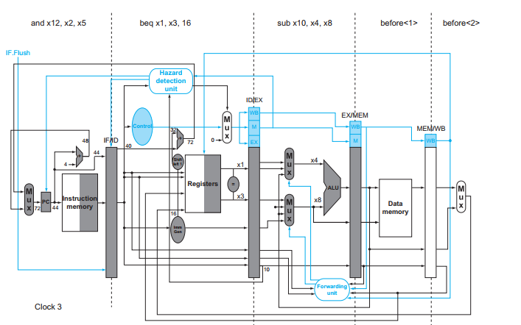
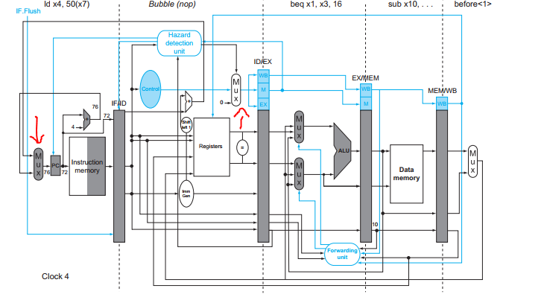
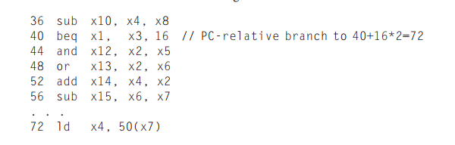
3.Hazard c. Control Hazard
To ﬂush instructions in the IF stage, we add a control line, called IF.Flush, that zeros the instruction field of the IF/ID pipeline register
Example:

Slide 20
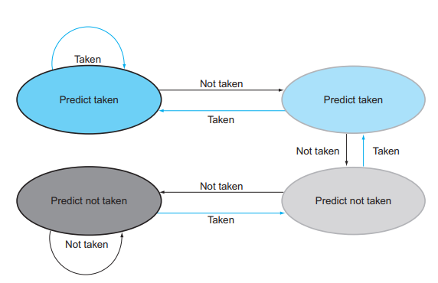
3.Hazard c. Control Hazard
For 5 stage pipeline, compiler-based condition is probably adequate. BUT the branch penalty increases when measured in clock cycles => With more hardware it is possible to try to predict branch
One way to approach is a branch prediction buffer or branch history. A branch prediction buffer is a small memory indexed by the lower portion of the address of branch instruction, and contains a bit – branch was recently taken or not.
BUT 1bit prediction scheme has a performance shortcoming ( chưa hiểu )
So they are replaced by 2bits scheme

Slide 21
3.Hazard c. Control Hazard
The 2-bit dynamic prediction scheme uses only information about a particular branch may not receive the best results.
=> using information about both a local branch and the global behavior of recently executed branches together yields greater prediction accuracy => correlating predictors
=> Other predictor: tournament branch predictor which uses multiple predictors => tracking, for each branch which predictor yields the best results

Slide 22
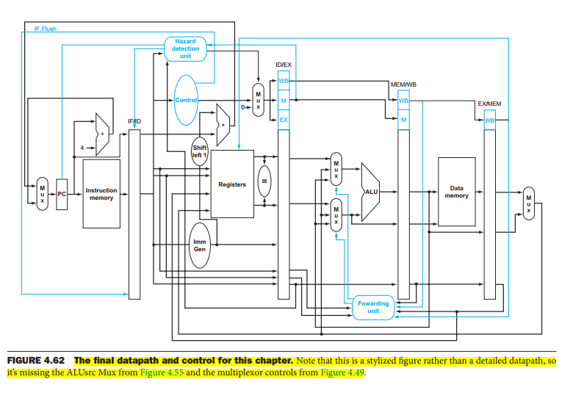
3.Hazard

Slide 23
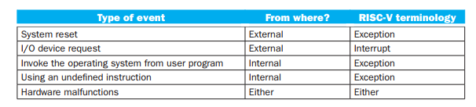
4.Exception a.Introduction
Exceptions: refer to any unexpected change in control ﬂow without distinguishing whether the cause is internal or external
Interrupts: refer to events is externally caused

Slide 24
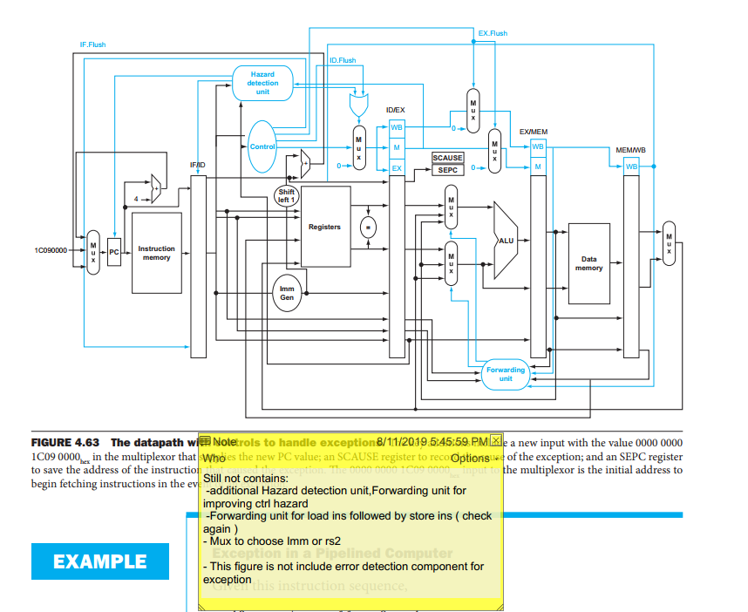
4.Exception b. Exceptions in the RISC-V Architecture
There are 2 types of exception are important in RISC-V: execution of undefined instruction or a hardware malfunction.
The basic action when exceptions occurs:
Save address of the unfortunate instruction in “supervisor exception cause register (SEPC)
Transfer control to the OS at some specified address
For the OS to handle the exception, it must know the reason => use a register – called SCAUSE – which holds a field that indicates the reason for the exception
Other method is to use “vectored interrupts”

Slide 25
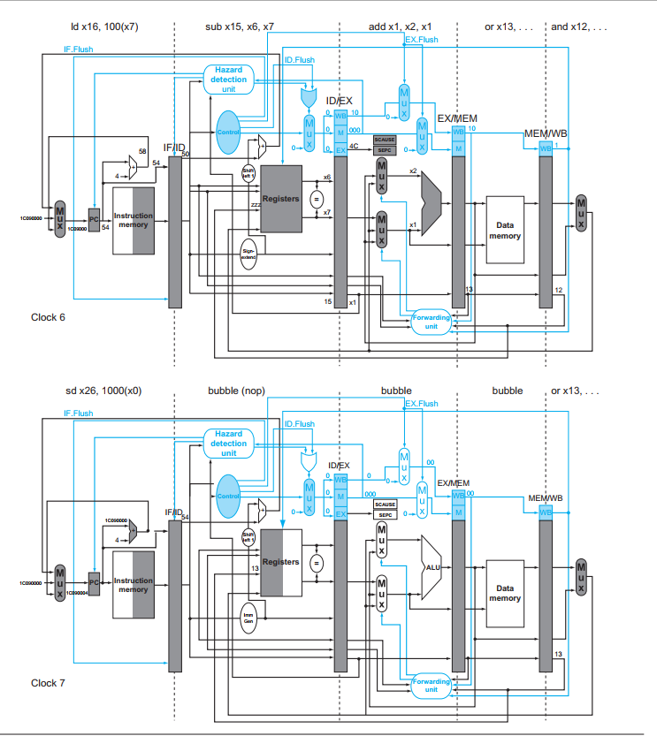
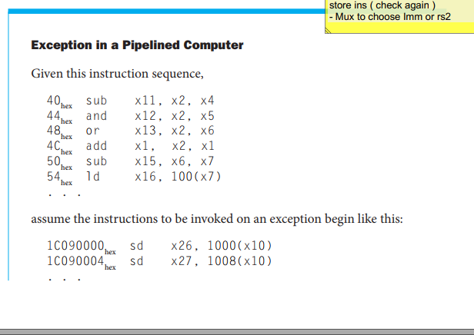
4.Exception b. Exceptions in the RISC-V Architecture (*) Example:

Slide 26
4.Exception b. Exceptions in the RISC-V Architecture
Multiple exceptions can occur simultaneously in a single clock cycle => Set prioritize the exceptions, it’s easy to determine which is serviced first.
“I/O device requests” and “hardware malfunctions” are not associated with a specific instruction => the mechanism used for other exceptions works just fine.
The hardware contract is normally to stop the offending instruction in midstream => let all prior instructions complete => ﬂush all following instructions => set a register to show the cause of the exception => save the address of the offending instruction => and then branch to a prearranged address.
For undefined instructions or hardware failure => Kill the program and return the cause
For I/O request or OS service call => Save the state of the program, perform desired tasks, restore the program to continue the program

